Slide 1



Electronic Dispensing Tool (EDT) Features and Uses
Emmanuel Ugburo
Div: Pharmaceutical Services

Slide 2
Course Objectives
At the end of this session participants should be able to:
Identify features of the EDT
Describe the features on the EDT used for dispensing and managing patient status changes.
Understand the various uses of the EDT

Slide 3
Background
Developed by the USAID –funded RPM Plus program in 2006 to meet the need for a practical data capturing and effective information management system for ARV medicines and patient data in the pharmacy
Enhancements were made to customize the EDT for the Namibia setting: features added included ability to print labels in local languages, creation of new reports and enhancement of reports available from the system and creation of an adherence module
Currently installed at 48 sites in Namibia (all the main sites and some outreach sites) meagre s

Slide 4
Overview of the EDT Features
The EDT comprises of two modules the:
Dispensing Module
Reporting Module

Slide 5
Dispensing Module
The Dispensing module has the following sections:
Patient section
Stock section
EDT mobile
Notes:
Facilitator should highlight all sections, however emphasize EDT mobile as the focus of the training

Slide 6
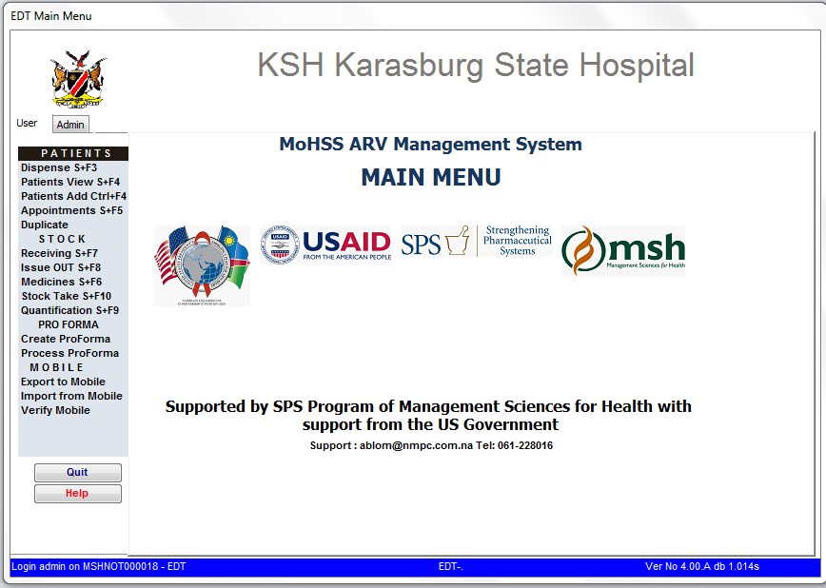
EDT Dispensing Module

Slide 7
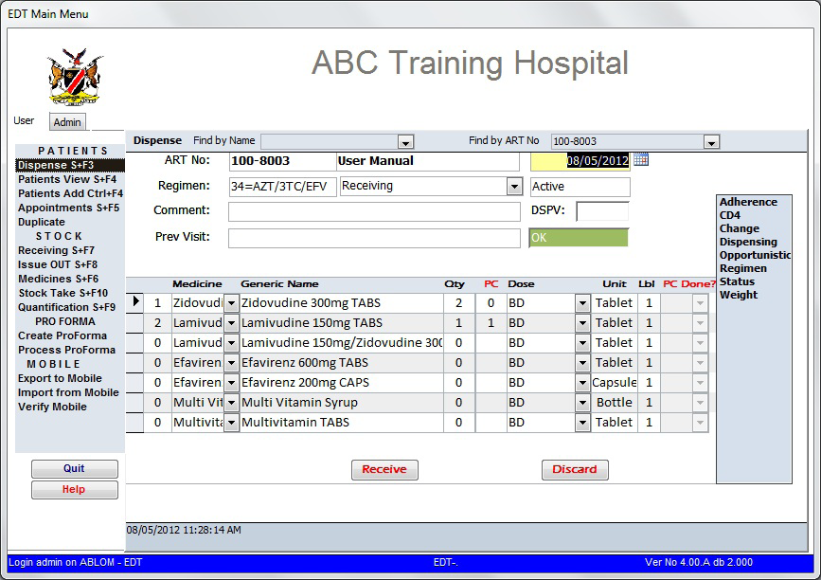
Dispensing View
Notes:
Start
Routine refilling
Receiving

Slide 8
Patient Data
Start Date
Current Regimen
Regimen History
Adverse effect
Patient status e.g T/in, In transit, LTFU

Slide 9
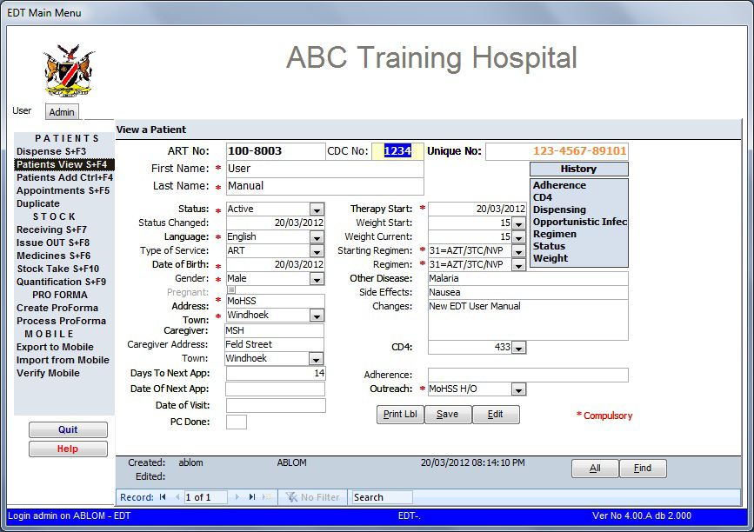
Patient View

Slide 10
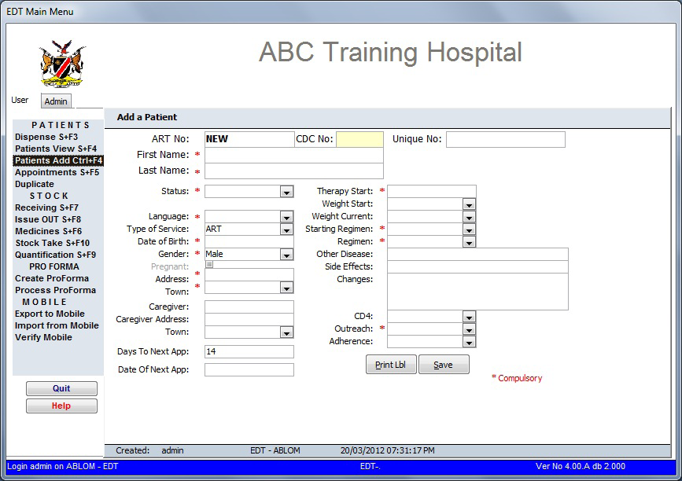
Adding New Patient

Slide 11
Patient section
Basic demographic data captured include:
Name
Age
Gender
Residential address
Contact Details
Notes:
Facilitator should use the EDT interphase and demonstrate how the basic demographic data are displayed in patients view

Slide 12
Stock Section
Management of stock is done by the following options;
receiving,
Issuing /transfers
stock take and
Quantification.

Slide 13
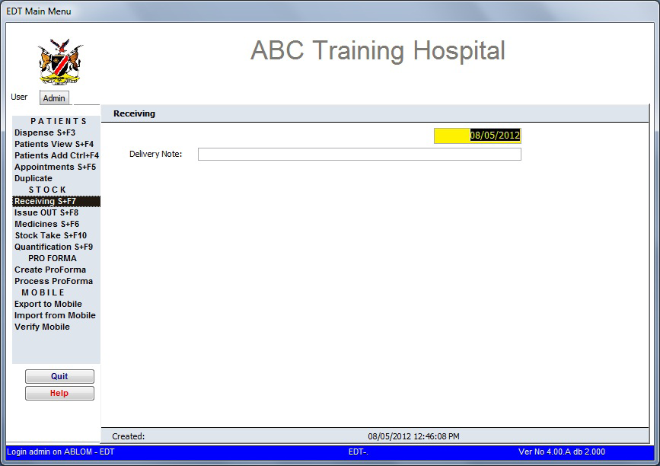
Receiving Medicines on the EDT

Slide 14
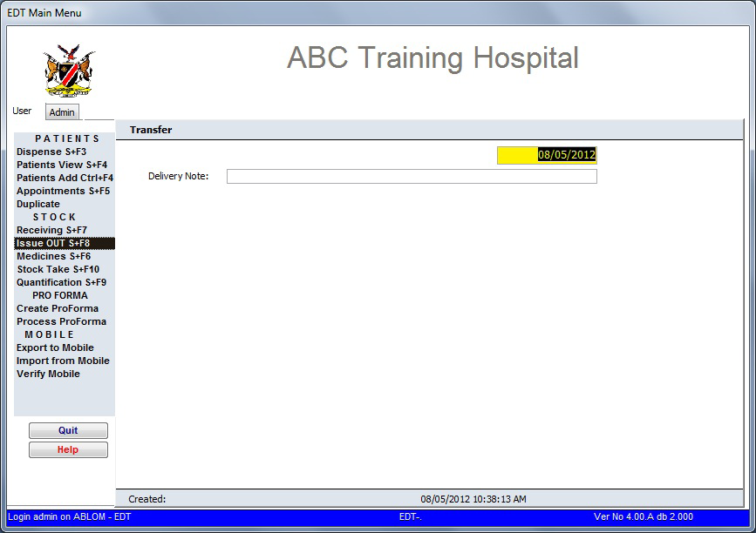
Issuing medicines on the EDT
Notes:
This will not be used for IMAI sites because when the IMAI sites returns the Mobile device and dispensing data are exported into the EDT, it will amount to double issuing.

Slide 15
ARV Medicine Stock Data
The EDT can provide critical stock data that are useful for decision making:
ARV Consumption Trend/History
Stock on Hand
Max/Min stock
Recommended Reorder Quantities (RRQ)

Slide 16
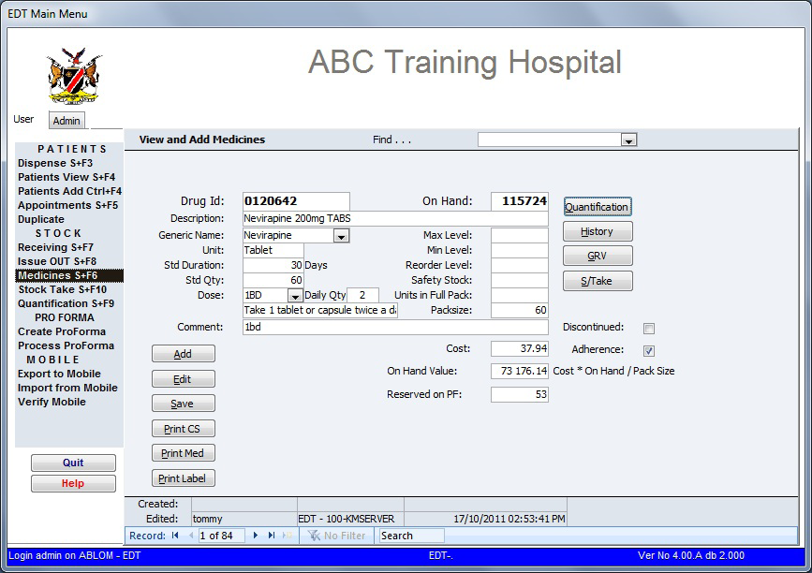
Stock Data

Slide 17
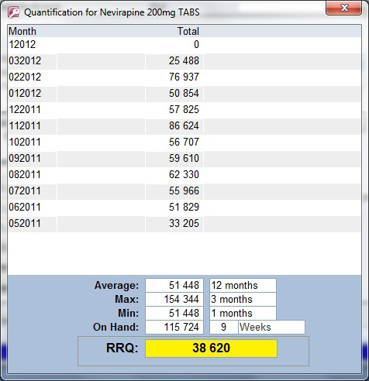
Quantification

Slide 18
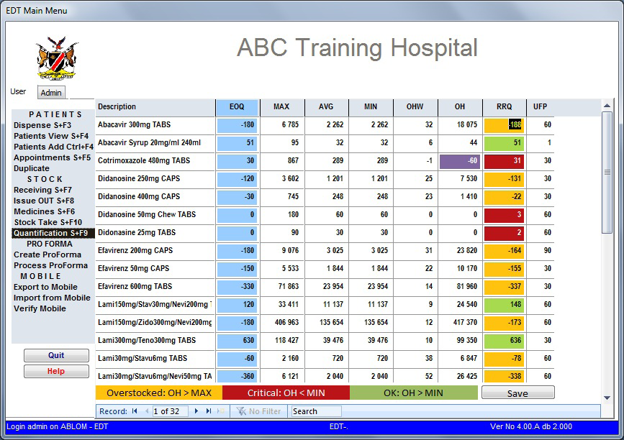
Consumption Summary & RRQ for Each Medicine

Slide 19
Reporting Module
The EDT processes the data entered into the system and its able to generate reports.
Reports could be either
Routine or Adhoc

Slide 20
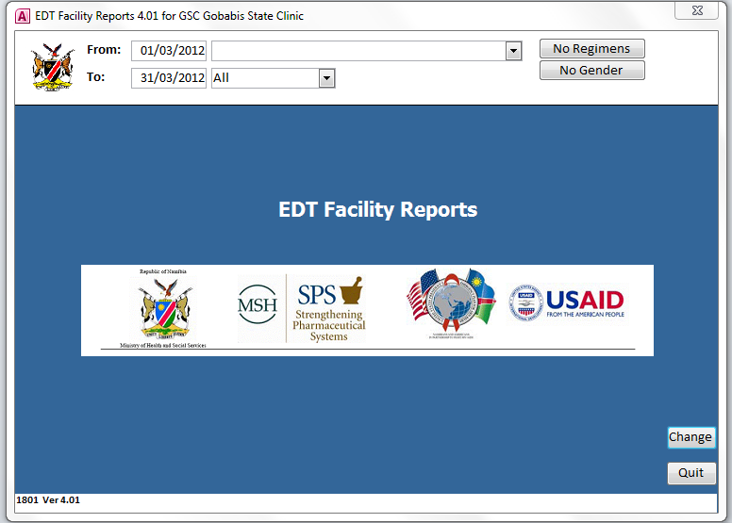
EDT Reporting Module

Slide 21
Routine Reports
New Patients Started by Regimen – Shows all patients Therapy Start within the date range, remembering that only valid PAMART numbers are thus counted. Incomplete numbers and abandoned take-on are excluded.
No of Pick-ups by Patient – this report displays the number of pick-ups in a month grouped by patient status, regimen, and age group. The statuses are Routine Refill, In-Transit, Restarted and Transferred-In. This report shows the number of patients served and not the number of scripts dispensed.
All Patients – this report shows the cumulative number of patients by status; including new patients started this period.
All Status Changes – Showing all patients who had status changes recorded in the date range.
All Switches – Shows all patients who had switches recorded in the date range.
Patients Late for appointment – Patients who collected medicines in the date range, but who were late for the appointment by number of days. Patients who did not collect medicines are excluded
On time ARV pickup (EWI4) – Patients who collected medicines on time (less than 4 days after date of appointment)

Slide 22
Adhoc Reports
Lost to follow up at 12 months (EWI02) – Number of patients initiating therapy 12 months ago who have not been seen at pharmacy for 90 days or more since date of last visit.
Patients Adherence – Shows percentage patient adherence for facility.
Patients retained on ART 12 months (EWI03) – Patients retained on ART 12 months after initiating on an appropriate first line regimen.

Slide 23
Adhoc Reporting
No of Scripts per Day – This report indicates the number of scripts dispensed per day. Also shows workloadItems Presumed out of stock – Presumed stock outage as at date of stock. Items on the list were counted with a zero value during stock take.
Current Stock Balance – This is the stock balance as on this instant. It is not taking into account the selected date range.
Medicine dispensed by Period – medicines dispensed for the selected period

Slide 24
Adhoc Reporting
Patients running out of ARV – During the selected period, how many patients who came for a refill had run out of any ARV medicine by the time of refill.
Facility Average Adherence – Shows facility adherence in graph format
Patients Not running out ARV – Patients who had medicine at the time of their refill.

Slide 25
Uses of EDT Data
The ART logistics pharmacist receives monthly ART reports from all the ART sites and aggregates and analyses this data using Excel-based templates.
A quarterly ART feedback report is compiled & disseminated to relevant stakeholders- facility and regional staff, ART program officers, partners etc.
Ad hoc analyses are also done on the NDB data and results of these analyses are discussed by the MoHSS’s Technical Advisory Committee (TAC) on HIV/ AIDS

Slide 26
Uses of EDT Data-examples
Adherence measuring and monitoring using standardised indicators that are based on pharmacy refill data e.g. on-time-pill-pick-up, pill coverage (medication-possession ration) and adherence based on pill count data
EDT data has been (and continues to be) used to provide data for the WHO HIV Drug Resistance Early Warning Indicators. This data has been published in international journals
Operational Research: e.g study on AZT-related anaemia in Namibia
ARV stocks consumption and stock status data is used by the MoHSS to conduct forecasting and quantification exercises

Slide 27
Conclusion
The EDT is an efficient data capturing tool
Reduces paper work
Historical data can be generated for reference purposes
Efficient and reliable in patient adherence monitoring and stock management
If you don’t record, you cannot report and if you don’t report , it means it was never done

Slide 28
Thank you

